Slide 1
Database System architecture

Slide 2
Database System architecture
The DBMS design depends upon its architecture. The basic client/server architecture is used to deal with a large number of PCs, web servers, database servers and other components that are connected with networks.
The client/server architecture consists of many PCs and a workstation which are connected via the network.
DBMS architecture depends upon how users are connected to the database to get their request done.

Slide 3
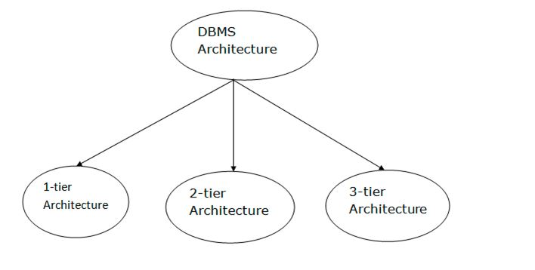
Types of DBMS Architecture

Slide 4
1-Tier Architecture
In this architecture, the database is directly available to the user. It means the user can directly sit on the DBMS and uses it.
Any changes done here will directly be done on the database itself. It doesn't provide a handy tool for end users.
The 1-Tier architecture is used for development of the local application, where programmers can directly communicate with the database for the quick response.

Slide 5
1 tier Architecture
The simplest of Database Architecture are 1 tier where the Client, Server, and Database all reside on the same machine.
Anytime you install a DB in your system and access it to practise SQL queries it is 1 tier architecture. But such architecture is rarely used in production.

Slide 6
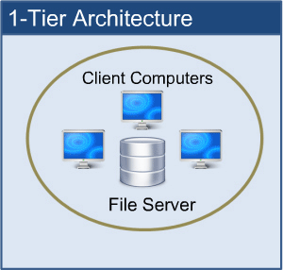

Slide 7
2-Tier Architecture
The 2-Tier architecture is same as basic client-server. In the two-tier architecture, applications on the client end can directly communicate with the database at the server side. For this interaction, API's like: ODBC, JDBC are used.
The user interfaces and application programs are run on the client-side.
The server side is responsible to provide the functionalities like: query processing and transaction management.
To communicate with the DBMS, client-side application establishes a connection with the server side.

Slide 8
2-Tier Architecture
A two-tier architecture is a database architecture where
Presentation layer runs on a client (PC, Mobile, Tablet, etc)
Data is stored on a Server.
An application interface which is called ODBC (Open Database Connectivity) an API which allows the client-side program to call the DBMS.
Today most of the DBMS offers ODBC drivers for their DBMS. 2 tier architecture provides added security to the DBMS as it is not exposed to the end user directly.
Example of Two-tier Architecture is a Contact Management System created using MS- Access.
Desktop Applications and games.

Slide 9
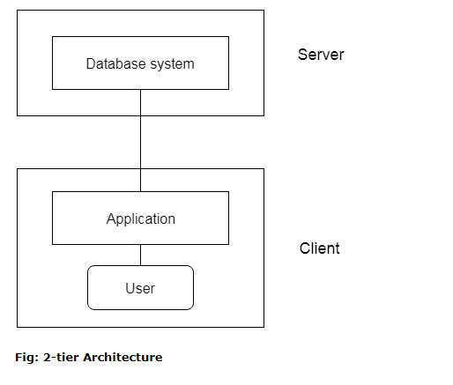
2-Tier Architecture

Slide 10
3-Tier Architecture
Presentation layer (your PC, Tablet, Mobile, etc.)
Application layer (server)
Database Server
This DBMS architecture contains an Application layer between the user and the DBMS, which is responsible for communicating the user's request to the DBMS system and send the response from the DBMS to the user.
The application layer(business logic layer) also processes functional logic, constraint, and rules before passing data to the user or down to the DBMS.
In this layer all business logic written like validation of data, calculations, data insertion etc

Slide 11
3-Tier Architecture
3) Data layer:
In this layer actual database is comes in the picture. Data Access Layer contains methods to connect with database and to perform insert, update, delete, get data from database based on our input data.
The application on the client-end interacts with an application server which further communicates with the database system.
End user has no idea about the existence of the database beyond the application server. The database also has no idea about any other user beyond the application.
The 3-Tier architecture is used in case of large web application.

Slide 12
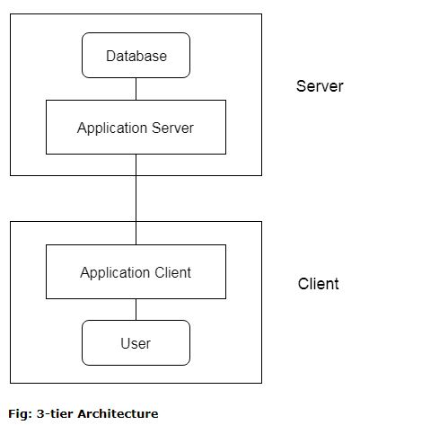
3-Tier Architecture

Slide 13
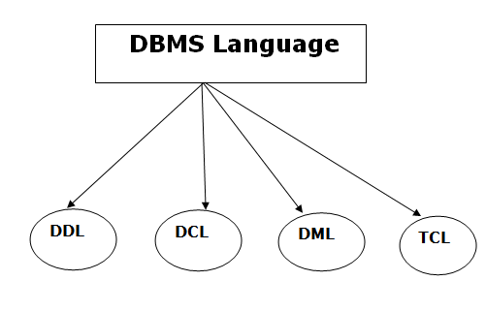
Types of Database Language

Slide 14
Data Definition Language
DDL stands for Data Definition Language. It is used to define database structure or pattern.
It is used to create schema, tables, indexes, constraints, etc. in the database.
Using the DDL statements, you can create the skeleton of the database.
Data definition language is used to store the information of metadata like the number of tables and schemas, their names, indexes, columns in each table, constraints, etc.

Slide 15
Data Definition Language
Create: It is used to create objects in the database.
Alter: It is used to alter the structure of the database.
Drop: It is used to delete objects from the database.
Truncate: It is used to remove all records from a table.
Rename: It is used to rename an object.
Comment: It is used to comment on the data dictionary

Slide 16
Data Manipulation Language
DML stands for Data Manipulation Language. It is used for accessing and manipulating data in a database. It handles user requests.
Select: It is used to retrieve data from a database.
Insert: It is used to insert data into a table.
Update: It is used to update existing data within a table.
Delete: It is used to delete all records from a table.

Slide 17
Data Control Language
DCL stands for Data Control Language. It is used to retrieve the stored or saved data.
The DCL execution is transactional. It also has rollback parameters.
Grant: It is used to give user access privileges to a database.
Revoke: It is used to take back permissions from the user.

Slide 18
Transaction Control Language
TCL is used to run the changes made by the DML statement. TCL can be grouped into a logical transaction.
Commit: It is used to save the transaction on the database.
Rollback: It is used to restore the database to original since the last Commit.

Slide 19
Database Transaction
A transaction is an action, or series of actions that are being performed by a single user or application program, which reads or updates the contents of the database.
A transaction can be defined as a logical unit of work on the database. This may be an entire program, a piece of a program or a single command (like the SQL commands such as INSERT or UPDATE) and it may engage in any number of operations on the database.
In the database context, the execution of an application program can be thought of as one or more transactions with non-database processing taking place in between.

Slide 20
Facts about Database Transactions
A transaction is a program unit whose execution may or may not change the contents of a database.
The transaction is executed as a single unit
If the database operations do not update the database but only retrieve data, this type of transaction is called a read-only transaction.
A successful transaction can change the database from one CONSISTENT STATE to another
DBMS transactions must be atomic, consistent, isolated and durable
If the database were in an inconsistent state before a transaction, it would remain in the inconsistent state after the transaction.

Slide 21
Data model
Data model - structure of database
Collection of tools to describe data, data relationships, data semantics, consistency constraints.
Provides a way to design physical, logical and view level

Slide 22
DBMS Database Models
A Database model defines the logical design and structure of a database and defines how data will be stored, accessed and updated in a database management system. While the Relational Model is the most widely used database model, there are other models too:
Hierarchical Model
Network Model
Entity-relationship Model
Relational Model

Slide 23
Hierarchical Model
This database model organises data into a tree-like-structure, with a single root, to which all the other data is linked.
The hierarchy starts from the Root data, and expands like a tree, adding child nodes to the parent nodes.
In hierarchical model, data is organised into tree-like structure with one one-to-many relationship between two different types of data, for example, one department can have many courses, many professors and of-course many students.

Slide 24
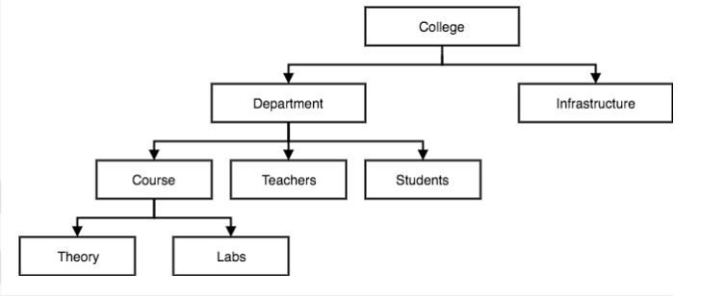
Hierarchical Model

Slide 25
Network Model
This is an extension of the Hierarchical model. In this model data is organised more like a graph, and are allowed to have more than one parent node.
In this database model data is more related as more relationships are established in this database model. Also, as the data is more related, hence accessing the data is also easier and fast. This database model was used to map many-to-many data relationships.
This was the most widely used database model, before Relational Model was introduced.

Slide 26
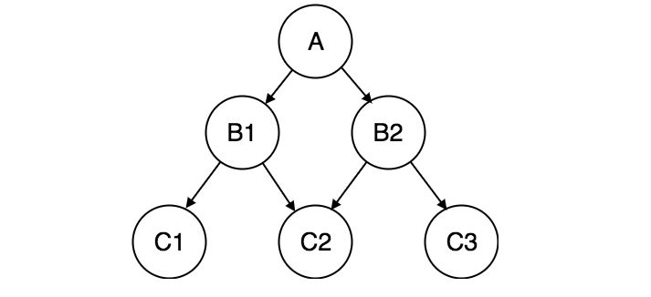
Network Model

Slide 27
Network Database Model | Hierarchical Database Model
Many-to-many relationship | One-to-many relationship
Easily accessed because of the linkage between the information | Difficult to navigate because of its strict owner to member connection
Great flexibility among the information files because the multiple relationships among the files. | Less flexibility with the collection of information because of the hierarchical position of the files.

Slide 28
Entity-relationship Model
In this database model, relationships are created by dividing object of interest into entity and its characteristics into attributes.
Different entities are related using relationships.
E-R Models are defined to represent the relationships into pictorial form to make it easier for different stakeholders to understand.
This model is good to design a database, which can then be turned into tables in relational model(explained below).
Let's take an example, If we have to design a School Database, then Student will be an entity with attributes name, age, address etc. As Address is generally complex, it can be another entity with attributes street name, pincode, city etc, and there will be a relationship between them.
Relationships can also be of different types.

Slide 29
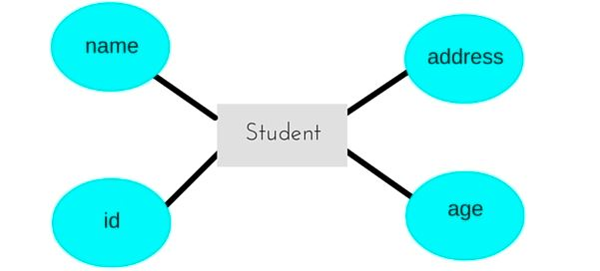
Entity-relationship Model

Slide 30
Relational Model
In this model, data is organised in two-dimensional tables and the relationship is maintained by storing a common field.
This model was introduced by E.F Codd in 1970, and since then it has been the most widely used database model, infact, we can say the only database model used around the world.
The basic structure of data in the relational model is tables. All the information related to a particular type is stored in rows of that table.
Hence, tables are also known as relations in relational model.
In the coming tutorials we will learn how to design tables, normalize them to reduce data redundancy and how to use Structured Query language to access data from tables.

Slide 31
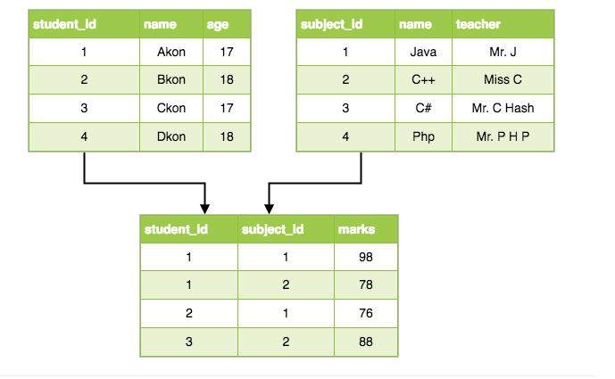
Relational Model

